Slide 1
DESIGN OF AR VR
ROHAN N KALPAVRUKSHA
ROSHAN N KALPAVRUKSHA

Slide 2
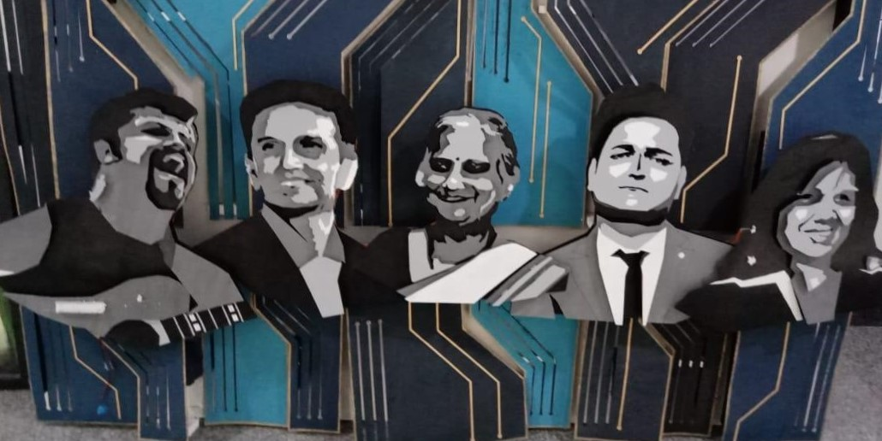
Augmented Reality
Image target
To guess the famous personalities of Karnataka

Slide 3
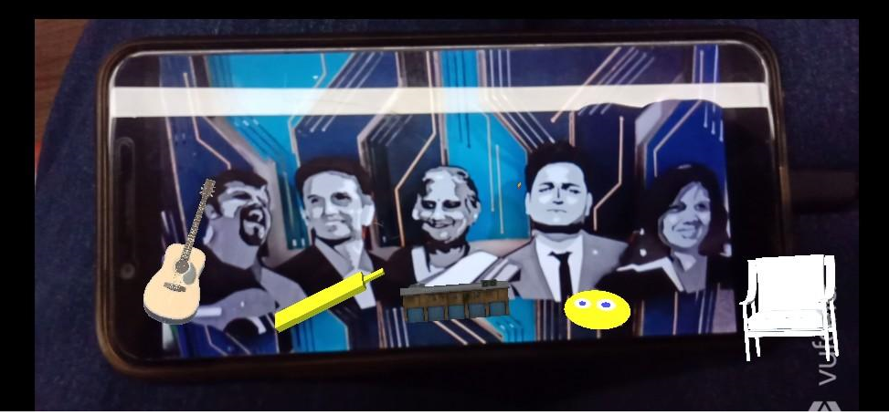
When you focus your camera on to the target image the clues pop up below each personality.
Guitar –Raghu Dixit
Bat –Rahul Dravid
Infosis Building –Sudha Murthy
Smile emoji-Kenny Sebastian
Chair-Kiran

Slide 4
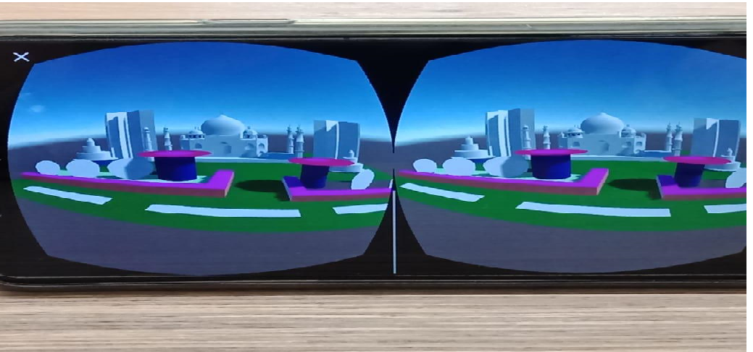
Virtual Reality
Taj Mahal at your place
Taj Mahal surrouned by settlements ,fountain, pathway, grass,boundary etc ...

Slide 5
What we learnt?
Sketchup- Helped me to create the world of my choice .Creativity
VR and AR-Visualise and bring it true .Imagination
Analytical Thinking
It made me feel that I can travel through the world that’s even more intresting and exciting

Slide 6
Valuing every moment spent here THANK YOU

